Slide 1
Gut microbiome alterations in Alzheimer’s disease
MCSA Journal Club
Vogt NM, Kerby RL, Dill-McFarland KA, Harding SJ, Merluzzi AP, Johnson SC, Carlsson CM, Asthana S, Zetterberg H., Blennow K, Bendlin BB, Rey FE.
Ellie Joung
Apr 3, 2019

Slide 2
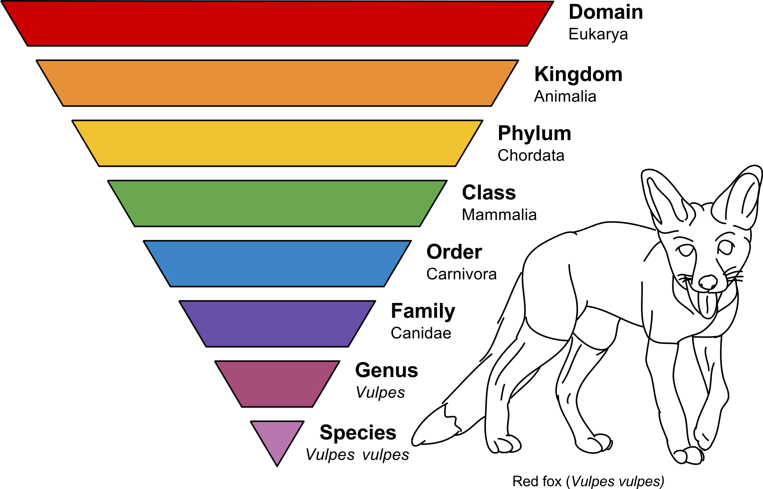
Terminology
Gut Microbiota: community of microorganisms in the gut
Gut Microbiome: genes inside microbial cells in the gut
Taxonomy

Slide 3
Introduction
Gut microbes perform key functions
Composition of gut microbes in an adult remains generally stable
Alternations in gut microbiome influence the brain through gut-brain axis
Preliminary data on dementia:
Altered bacteria abundance in the gut in individuals with positive amyloid-PET
Notes:
Despite the proposed role of gut microbiota in the development or progression of AD, there have been no comprehensive studies of the gut microbiome in AD patients
1. e.g. energy extraction, biosynthesis of vitamins, protection against pathogen overgrowth, etc.
3. e.g. autism spectrum disorder, MS, PD

Slide 4
Study Objectives
To characterize gut microbial communities in Control and AD individuals
To associate gut microbiota and AD pathology measured by CSF biomarkers of AD

Slide 5
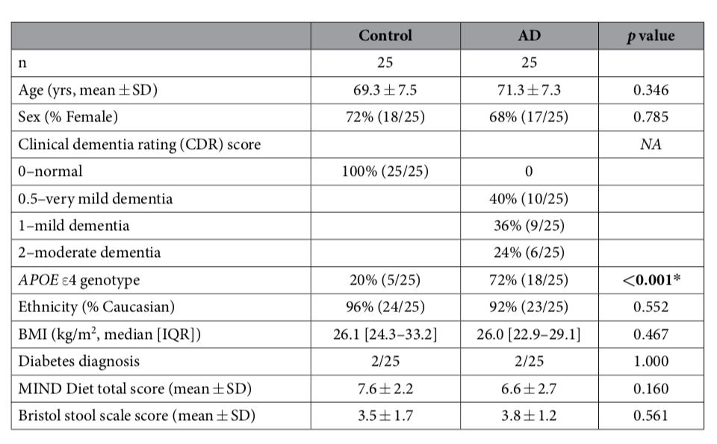
Participant Characteristics
25 AD (CDR score 0.5-2) and 25 Control recruited from Wisconsin AD Research Center
24/25 AD participants were taking acetylcholinesterase inhibitor and/or memantine
Groups did not differ in age, sex, ethnicity, BMI, or diabetes status

Slide 6
Study Design
Fecal sample was collected at home and returned by overnight delivery sample collection kits
DNA was extracted from the fecal samples for bacterial 16S rRNA sequencing
DNA sequence reads were clustered into operational taxonomic units (OTU) based on 97% similarity and assigned the lowest possible taxonomic classification
Notes:
From GreenGenes database

Slide 7
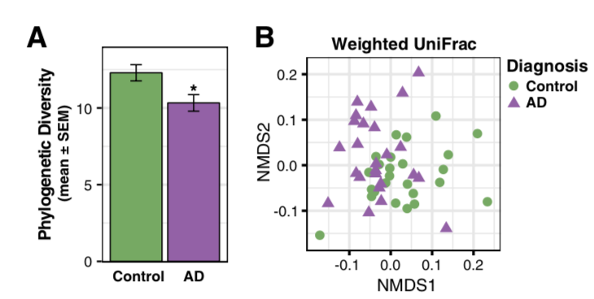
AD is associated with changes in the gut microbiome
Composition of microbiome characterized by:
Richness: number of OTUs present in a participant
Alpha diversity: richness and abundance of OTUs within each participant
Beta diversity: how different the composition of microbiome is between participants
Alpha diversity
Beta diversity
Notes:
Weighted unifrac: quantitative method to examine differences in microbial community structure; it incorporates phylogenetic distances between observed organisms
NMDS is used to collapse information from multiple dimensions (multiple microbial communities) in a fw so they can be visualized

Slide 8
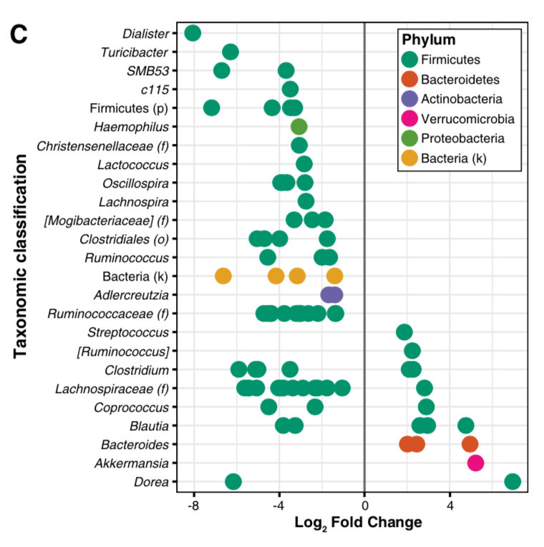
AD is associated with changes in the gut microbiome
Differential Abundance Analysis at OTU level
Notes:
14 OTUs more abundant and 68 OTUs less abundant in AD

Slide 9
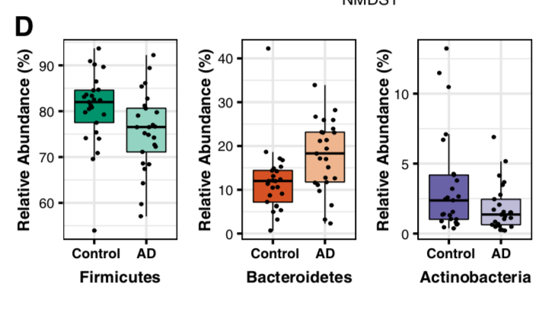
AD is associated with changes in the gut microbiome
OTUs grouped at the phylum level
Notes:
Firmicutes and bacteroidetes are the two dominant phyla that make up about 80% of the gut microbiome.

Slide 10
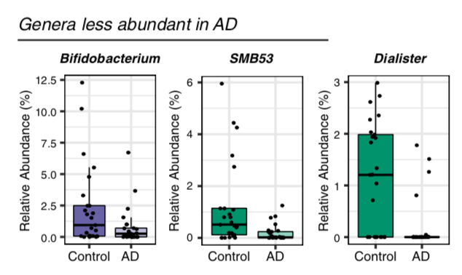
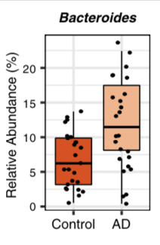
AD is associated with changes in the gut microbiome
OTUs grouped at the genus level
Bifidobacterium genus
Beneficial health effects
Anti-inflammatory properties
Bacteroides genus
LPS triggers pro-inflammatory responses
Notes:
Decrease LPS levels in intestine in mice

Slide 11
Gut-Brain Axis
Exacerbate AD pathology
Brain
Gut
Systemic circulation of bacteria and LPS
Release of pro-inflammatory cytokines
Intestinal epithelium
LPS
Bacteroides
Notes:
There are other mechanisms of the gut brain axis including neural and endocrine pathways

Slide 12
Genera abundance is correlated with CSF biomarkers of AD pathology
CSF analysis included:
9 AD participants from primary analysis
10 Controls from primary analysis
21 Younger control participants
Biomarkers:
Aβ42/Aβ40
P-tau
P-tau/Aβ42
Notes:
The 10 Controls and 21 younger controls were combined in the analysis into Non-demented (ND) group

Slide 13
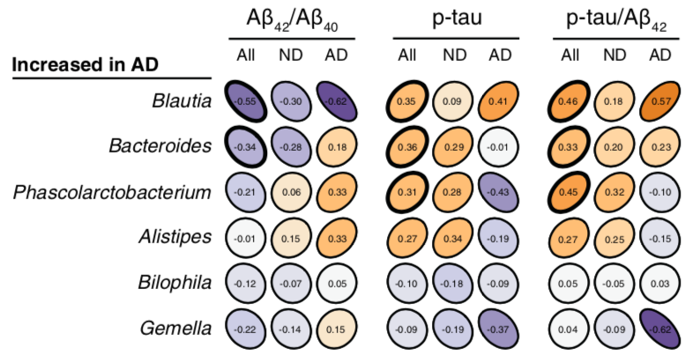
Genera abundance is correlated with CSF biomarkers of AD pathology
Genera identified as more abundant in AD were associated with greater AD pathology
Even in absence of dementia (ND), the relationship between the genera and amyloid and tau protein markers remained the same
Notes:
They used a test called spearman’s rank, which measures the strength and direction of association between the two variables, which are genera and the CSF biomarkers. They analyzed the correlation of each genera to the biomarkers within the AD and Control groups separately and then in all groups
So for example, bacteroides, which are increased in AD, are negatively associated with AB42/AB40 in CSF, which means there is higher deposition of amyloid in the brain associated with this genera. Similarly, the genus was positively associated with p-tau and p-tau/AB42.

Slide 14
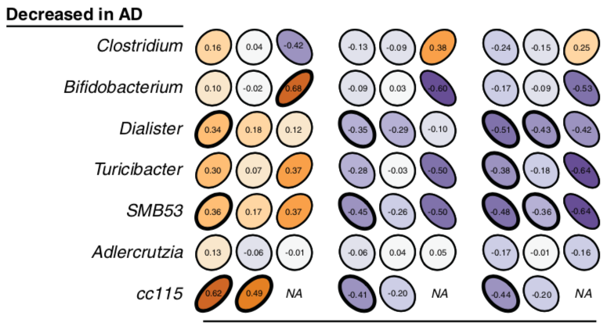
Genera abundance is correlated with CSF biomarkers of AD pathology
Genera less abundant in AD are associated with higher Aβ42/Aβ40 and lower p/tau and p-tau/Aβ42
Dialister and SMB53 showed strongest negative correlations in ND participants ->
They might be protective against development or progression of AD pathology
Notes:
These effects were most prominent when examining CSF p-tau/Aβ42

Slide 15
Conclusion
Gut microbiome composition of AD and Control participants differ on OTU, phylum, and genera level
Genera associated with pro-inflammatory immune responses are more abundant in AD participants
These genera are also associated with higher p-tau and p-tau/Aβ42 levels in CSF
Genera less abundant in AD participants are associated with lower AD pathology
Limitations:
AD participants and Controls differ with respect to SSRI and AD medications
Unknown effects of AD medications on gut microbiome

