Slide 1
Conference in MCSA
2019. 10. 9
In vivo direct relation of tau pathology with neuroinflammation in early Alzheimer’s disease
Tatsuhiro Terada^{1,2}
Visiting scholar in McGill University Research Centre for Studies in Aging
¹ Department of Biofunctional Imaging, Preemenent Medical Photonics Education & Research Center, Institute for Medical Photonics Research, Hamamatsu University School of Medicine, Hamamatsu, Japan.
² Department of Neurology, Shizuoka Institute of Epilepsy and Neurological Disorders, Shizuoka, Japan.
Notes:
We would like to present tau deposition and microglial activation in the living brain of early-stage Alzheimer disease.

Slide 2

Neurologist (Samurai) in Japan.
My interest in AD
Early diagnosis
Key to the treatment
By using・・・
・PET
・VBM
・Neuropsychological Battery Tests
・CSF biomarker

Slide 3
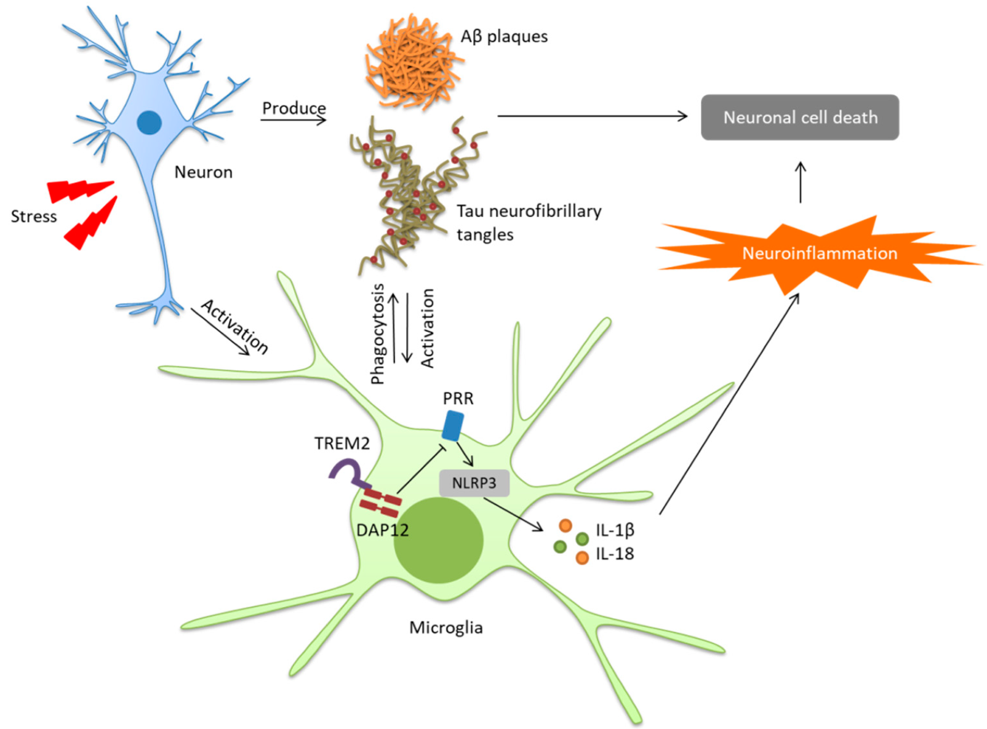
Introduction
In the progression of Alzheimer’s disease (AD), neuroinflammation, β-amyloid (Aβ), and tau are worth noticing as pathological culprits.
Yuan, Int. J. Mol. Sci. 2019
Aβ accumulation activates microglia, which, in turn, accelerates Aβ accumulation by releasing inflammatory substances. (Li, Biomed Res Int 2014, Zhang, Neuropsychiatr Dis Treat 2015)
Notes:
In addition to the Amyloid-beta and tau, neuroinflammation is considered a key feature of AD.
It remains unclear whether tau pathology and neuroinflammation occur in parallel.
Tau and activated microglia can be depicted with a newly developed PET tracers PBB3 and DPA.
The purpose of the present study was to clarify the in vivo relationship between tau deposition and neuroinflammation and their influence on clinical perfrormance.

Slide 4
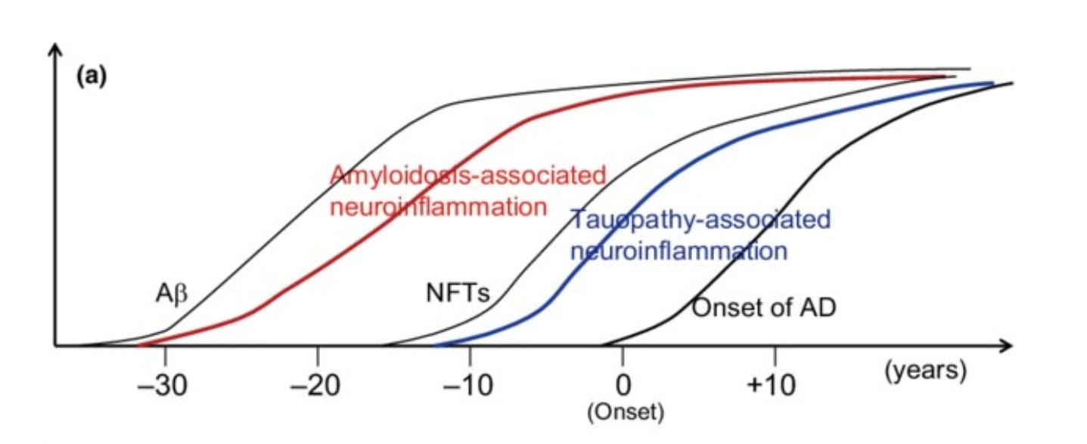
In addition to the Aβ, tau induce the activation of microglia.
Saito, Neuroimmunology 2018
However, it remains unclear how tau proteins are associated with neuroinflammation and clinical manifestations in vivo.
In the debates about future treatments for AD (anti inflammatory drug), evaluation of neuroinflammation and understanding the association between abnormal protein deposition are important.
The purpose of this study was to clarify how tau pathology is associated with neuroinflammation by using PET.
Notes:
In addition to the Amyloid-beta and tau, neuroinflammation is considered a key feature of AD.
It remains unclear whether tau pathology and neuroinflammation occur in parallel.
Tau and activated microglia can be depicted with a newly developed PET tracers PBB3 and DPA.
The purpose of the present study was to clarify the in vivo relationship between tau deposition and neuroinflammation and their influence on clinical perfrormance.

Slide 5
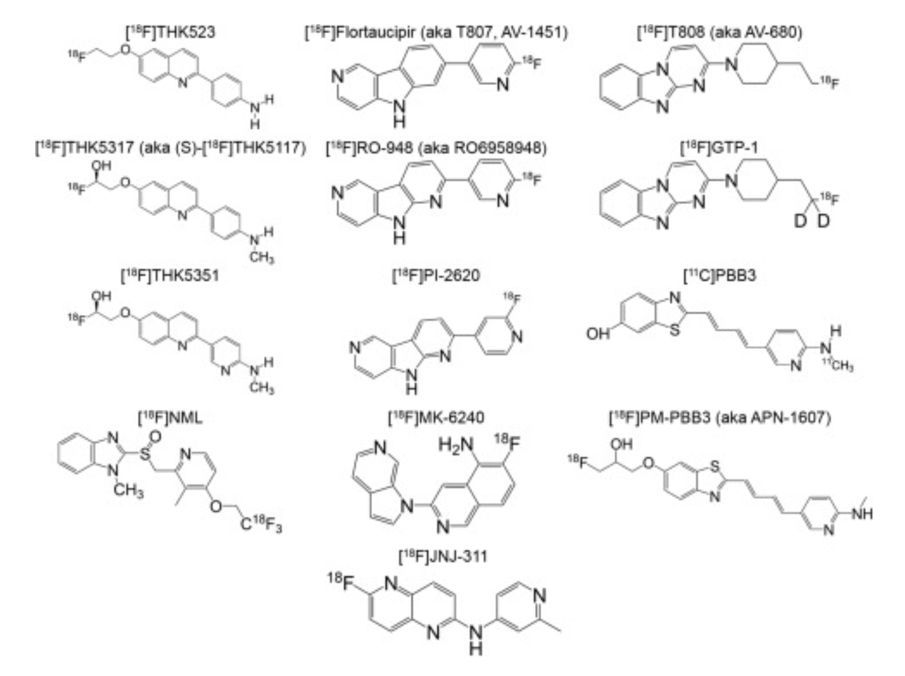
Tau PET tracer

Slide 6
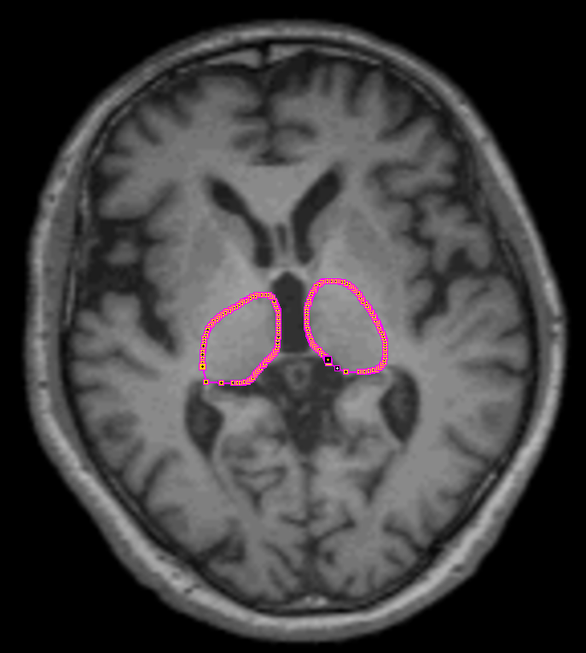
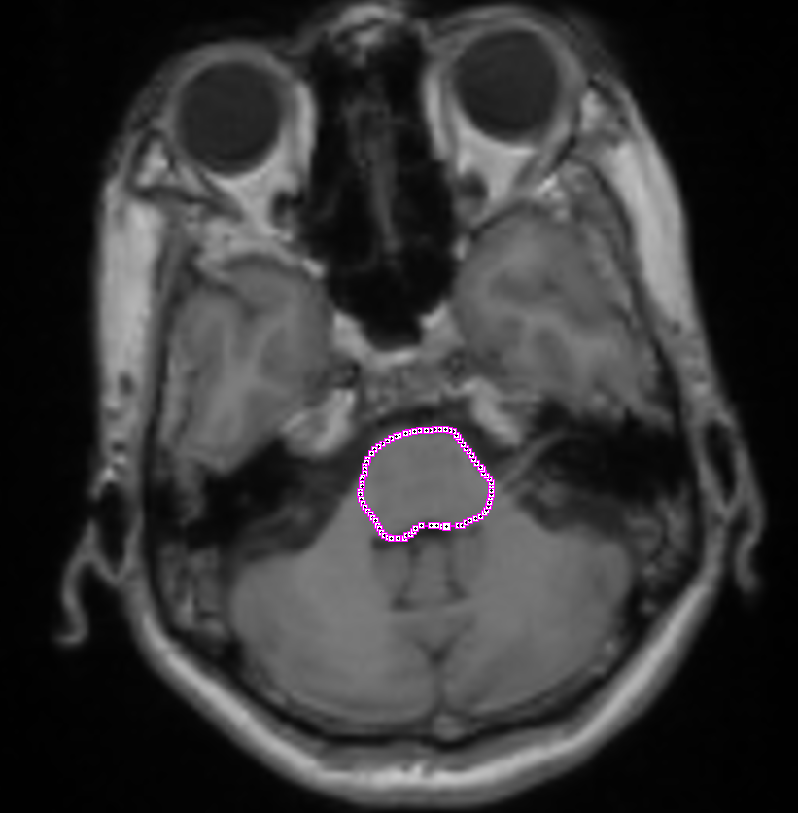
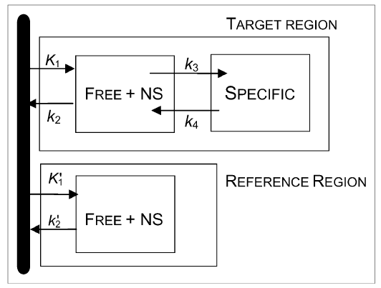
Image Data Processing of [¹¹C]PBB3
Simplified Reference Tissue Model (SRTM)
ROIs were manually set bilaterally over the bilateral and pons on each subject on MR image.
kBq/cc
Time Activity Curve
Thalamus
Target curve
Pons
Reference curve
min
Notes:
In SRTM, the thalamus was chosen as a rich region, and the pons was chosen as a reference region.

Slide 7
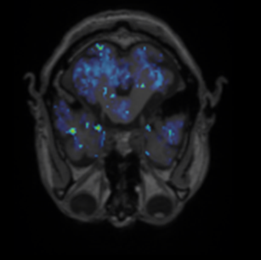
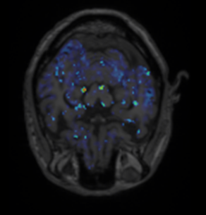
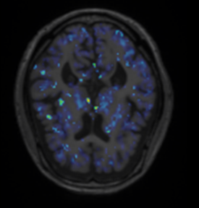
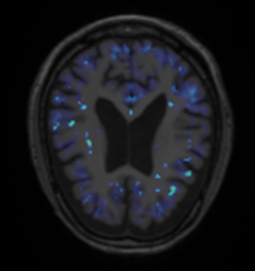
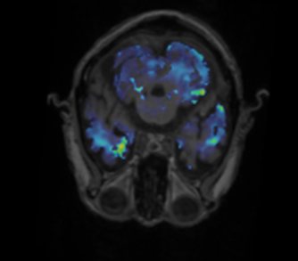
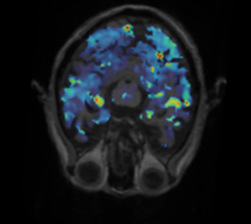
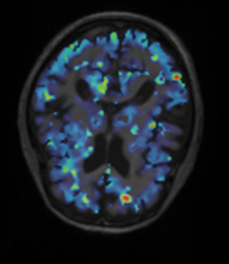
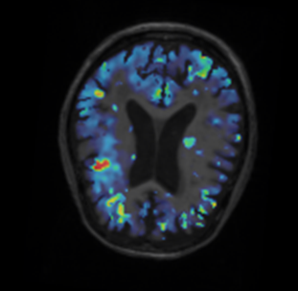
[¹¹C]PBB3 PET BP_{ND} image
3.0
Normal control
0
AD patients(CDR1)
Notes:
今回、用いるDPA-PETは、近年開発されたTSPOに対するPETトレーサーで、活性化ミクログリアを可視化することができます。
これまで、ミクログリアの活性評価に用いられてきた、PKに比べて特異性が高いことが特徴です。
正常者におけるDPA-PETの一例です。
MRIとPET画像の融合画像で表示してあります。
左のカラーバーが示すように、赤がより集積が強く、青は集積がすくないことを示します。
正常では、視床に軽度集積を認める以外、おおきな集積は認めません。

Slide 8
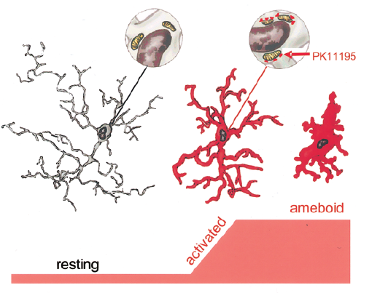
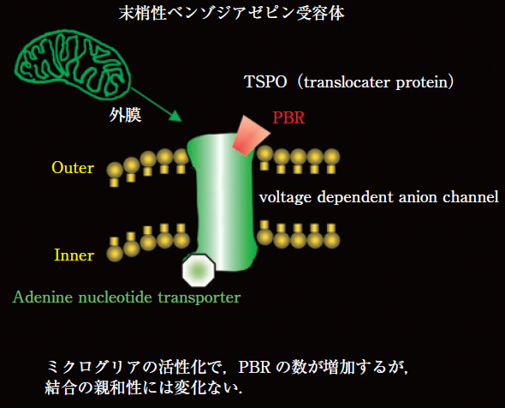
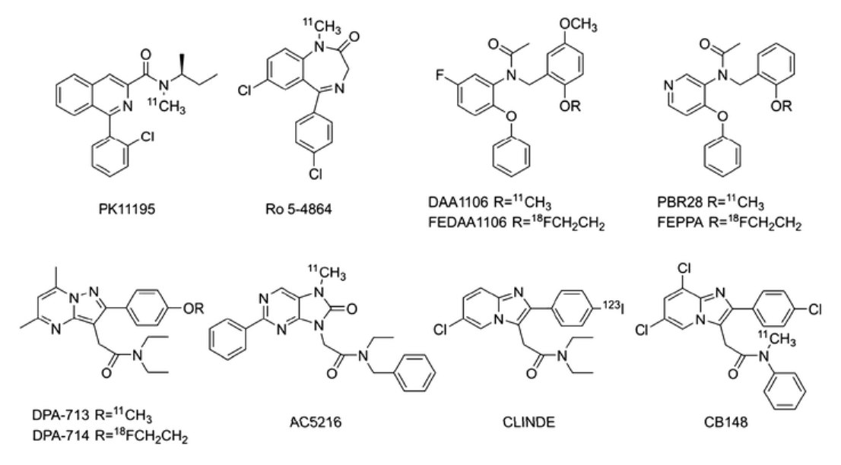
Translocator Protein (TSPO)
TSPO
microglia
(Banati RB, 2002)
TSPO PET tracer
Neuroinflammation
During the activation of microglia, these cells express increasing amounts of TSPO on the outer membrane of mitochondria, which makes TSPO a marker of neuroinflammation in the brain.
Notes:
During the activation of microglia, these cells express TSPO.
A new tracer DPA has been reported to have a higher affinity for TSPO.

Slide 9
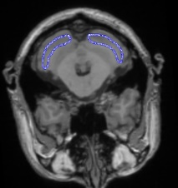
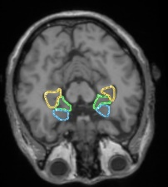
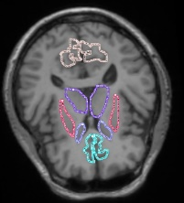
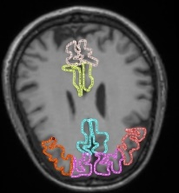
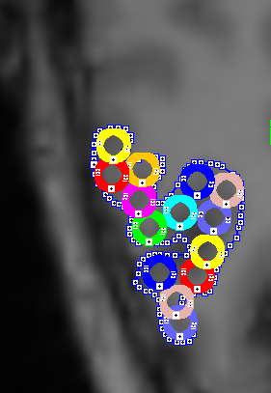
Image Data Processing of [¹¹C]DPA713
SRTM
A NIC was created by averaging the TACs from all ROIs in the controls
normalized input curve (NIC)
plasma
tissue
NIC was adjusted to the lowest TAC peak in the individual subjects
[kBq/cc]
Thalamus
Rich region (Target)
Cluster analysis
To find the reference region
1, Small ROI of 2 mm in diameter
were placed
2, The lowest peak TAC was
determined
Less region (Reference)
[sec]
Notes:
つぎに、reference カーブを基準として、対象領域で、どの程度放射能濃度が上がっているかを判断します。
対象領域は、DPAに対するレセプターが豊富な視床を選択しました。
DPAは、４Kモデルと考えられているため、referenceとtargetカーブから、ローガンプロットを利用した参照領域法（SRTM）でBP画像を作成します。

Slide 10
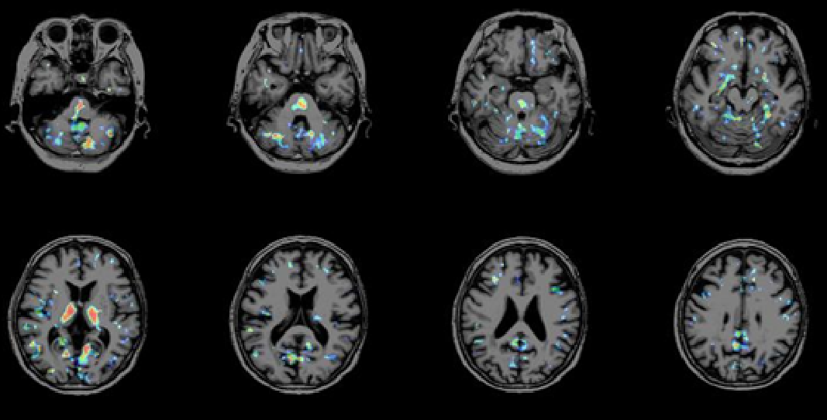
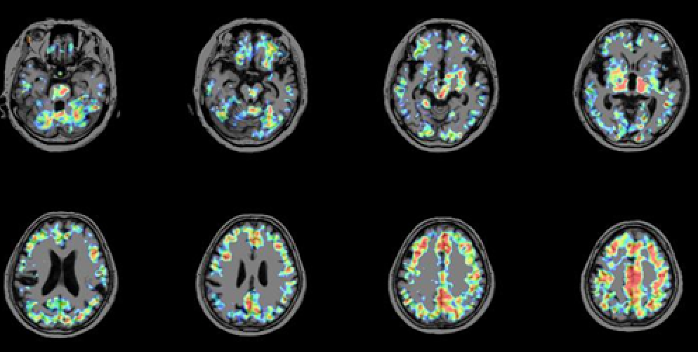
[¹¹C]DPA713 PET BP_{ND} image
Normal control
1.5
AD patients
(CDR1)
0
Notes:
今回、用いるDPA-PETは、近年開発されたTSPOに対するPETトレーサーで、活性化ミクログリアを可視化することができます。
これまで、ミクログリアの活性評価に用いられてきた、PKに比べて特異性が高いことが特徴です。
正常者におけるDPA-PETの一例です。
MRIとPET画像の融合画像で表示してあります。
左のカラーバーが示すように、赤がより集積が強く、青は集積がすくないことを示します。
正常では、視床に軽度集積を認める以外、おおきな集積は認めません。

Slide 11
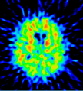
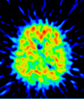
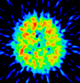
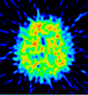
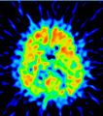

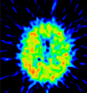













Patients
[¹¹C]PiB PET in the patients with AD
patient1
patient2
patient3
patient4
patient5
patient6
patient7
patient8
patient9
patient10
patient11
patient12
patient13
patient14
patient15
patient16
patient17
patient18
patient19
patient20
All AD patients showed [¹¹C]PIB uptake in the cortex.

Slide 12

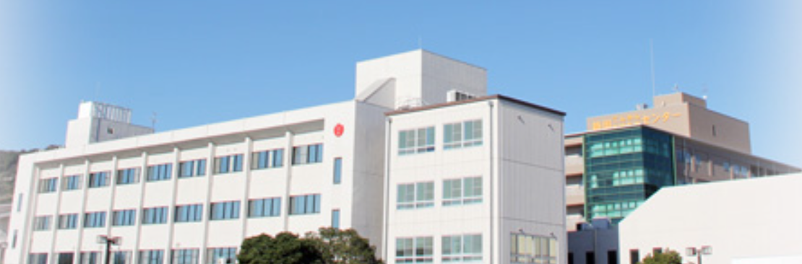
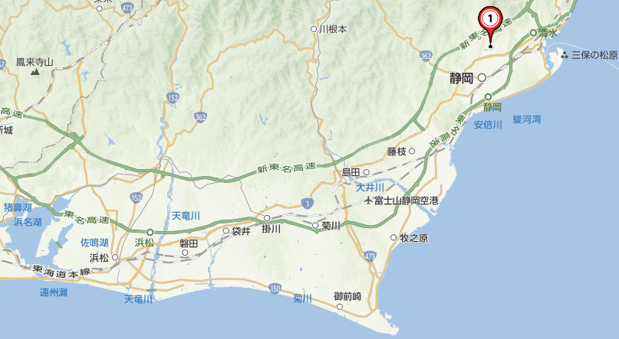


Patients recruit
Kyoto
Tokyo
Shizuoka Institute of Epilepsy and Neurological Disorders
Shizuoka
PET measurement
Hamamatsu
Mount Fuji
Hamamatsu University School of Medicine
and
Hamamatsu Photonics K.K
Shinkansen - Bullet Trains

Slide 13
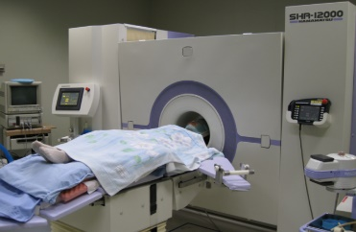
Methods
1. PET scanning
All participants underwent [¹¹C] PBB3 and [¹¹C]DPA713 PET measurement to evaluate the tau deposition and microglial activation.
The binding potential (BP_{ND}) was estimated on the SRTM using PMOD 3.4 software.
All participants underwent series of PET measurements by using High-resolution brain PET scanner(SHR12000, Hamamatsu Photonics K.K., Hamamatsu, Japan).
Trans mission: 10min
Serial scan: 62min
(30secx4, 30secx20, 300secx8)
Notes:
Twenty AD patients and age-matched twenty normal controls were recruited in this study.
All participants underwent PBB3 and DPA PET measurement.
The binding potential was estimated on the simplified reference tissue model.
13

Slide 14
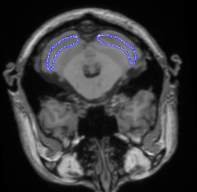
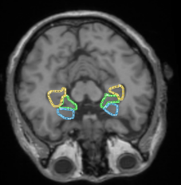
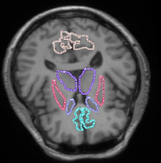

2. SPM analysis
To identify the regions in which AD patients showed higher level of tau deposition or microglial activation in the AD group compared to control group, we underwent two-sample t-test using SPM8.
Age and gender were treated as covariates of no interest.
3. Manual Region of Interest (ROI) analysis
To explore the relationship between tau deposition and microglial activation, direct comparison in the same manual ROIs were carried out.
Path analyses among data for [¹¹C]PBB3 uptake, [¹¹C]DPA713 uptake and psychological test scores were performed in all patients with AD.
ROIs were manually set bilaterally over the bilateral frontal and temporal cortex, thalamus, basal ganglia, and cerebellar hemisphere on each subject on MR image.
Notes:
In addition, PIB PET examination was performed to confirm the diagnosis of AD.
Furthermore, to evaluate glucose metabolism, FDG PET examination was also performed.
To identify the regions in which AD patients showed higher level of tau deposition or microglial activation in the AD compared to control,
we underwent two-sample t-test using SPM8.
In addition, to assess the relationship between tau pathology and activated microglia or other clinical feature, correlation analysis and ROI analysis were also conducted.

Slide 15
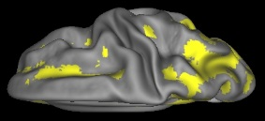
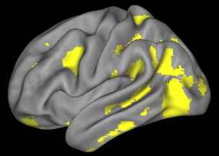
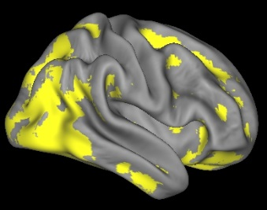
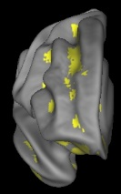
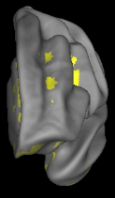
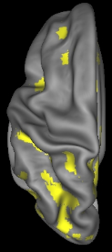
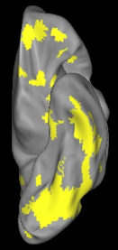
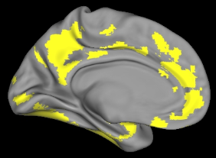
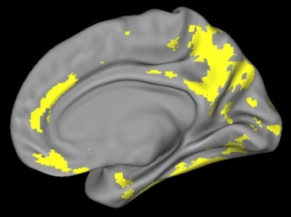
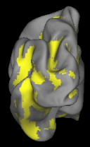
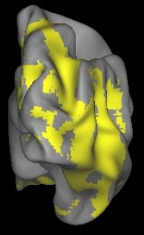
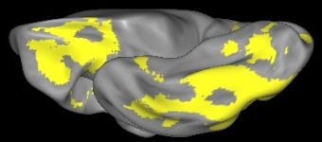
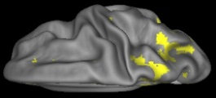
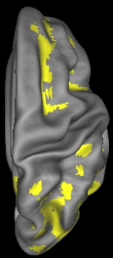






















Results
1. Comparison of [¹¹C]PBB3 BP_{ND} between AD and control
Distribution and progression pattern of tau deposition
(a)Total AD vs. control
Uncorrected p<0.001
Extent threshold k = 0
(b)CDR0.5 AD vs. control
(c)CDR 1 AD vs. control
→ The distribution and progression pattern of the tau deposition may be consistent with the previous reports of Braak tau stage in AD.
Notes:
● The total AD patients group showed a significantly higher level of [¹¹C]PBB3 BP_{ND} in the temporal, parietal, and frontal cortices compared to normal control group.
● The AD subgroup at the CDR 0.5 showed a significant increase in [¹¹C]PBB3 BP_{ND} especially in the temporal and parietal cortices. Increases in [¹¹C]PBB3 BP_{ND} were found more broadly in the AD subgroup at the CDR1

Slide 16




































2. Comparison of [¹¹C]DPA BP_{ND} between AD and control
Distribution and progression pattern of microglia activation
(a)Total AD vs. control
Uncorrected p<0.001
Extent threshold k = 0
(b)CDR0.5 AD vs. control
(c)CDR 1 AD vs. control
→ Microglial activation was globally present even at an early stage of AD.
Notes:
Increases in [¹¹C]DPA BP_{ND} were found more broadly in the AD subgroup at CDR1.

Slide 17




3. Relationship between [¹¹C]PBB3 BP_{ND} and [¹¹C]DPA BP_{ND} in the same manual ROI (direct relationship) in AD
(A) parahippocampus
(B) medial temporal cortex
(C) ｌateral temporal cortex
R²=0.400
p=0.015
R²=0.165
p=0.375
R²=0.002
p=0.846
[¹¹C]DPA BP_{ND} in parahippocampus
[¹¹C]DPA BP_{ND} in medial temporal cortex
[¹¹C]DPA BP_{ND} in lateral temporal cortex
[¹¹C]PBB3 BP_{ND} in parahippocampus
[¹¹C]PBB3 BP_{ND} in medial temporal cortex
[¹¹C]PBB3 BP_{ND} in lateral temporal cortex
→ These findings support the idea that tau burden accelerates microglial activation.

Slide 18
5.The path analysis among [¹¹C]PBB3, [¹¹C]DPA713 and
dementia score MMSE using (manual ROI analysis) in AD
(A)
(B)
→ In the early stage of AD, medial temporal tau accumulation is directly correlated with cognitive dysfunction and neuroinflammation.
→ As dementia deteriorates, latera temporal tau accumulation is associated with cognitive dysfunction without direct linkage with neuroinflammation because neuroinflammation may approach to the maximal level in the brain.

Slide 19
Limitation
■ Lack of genetic testing of TSPO
→ Although Japanese people have been reported to have a moderator homogeneous pattern of polymorphism for TSPO, there is a chance that patients with low or high affinity might been included.
■ Because Aβ also induce neuroinflammation, a comparative study is needed to clarify how much Aβ contributes to microglial activation.
→ In the manual ROI analysis, we failed to show any relationship between for [¹¹C]DPA uptake, [¹¹C]PiB uptake.
Saito, Neuroimmunology 2018

Slide 20

Why only in the parahippocampus?
■ Although the progression pattern of activated microglia was similar to that of the tau deposition, there was site-by-site relationship only in the right hippocampus area.
→ One possible explanation for this discrepancy is that the microglia were already activated early in the disease process and that the activation level reaches a plateau.
Microglical activation level reached plateau?
preclinical
MCI
dementia
Notes:
We showed the microglial activation in the whole brain in AD patients.
Present study indicated that microglial activation was globally present even at an early stage of AD.
In the right hippocampus, positive correlation was found between tau deposition and activated microglia in the group of AD and controls.
Several studies indicated that normal aging was associated with tau deposition in the medial temporal lobe.
On the other hand, activated microglia accompanies any damage of the brain.
Therefore, tau pathology seen during the aging process and post-AD degeneration might trigger activation of microglia

Slide 21

Mitochondrial cascade hypothesis
Mitochondria are considered not only a bioengine for energy production but also an intracellular source of reactive oxygen species (ROS) that induce damage.
Xinglong, BBA 2013
In addition to the tau and Aβ, mitochondrial dysfunction might contribute to the neuroinfammation.
Notes:
It has been increasingly apparent that mitochondrial dysfunction plays a significant role in the pathology of AD.
No in vivo study exists about the difference between glucose hypometabolism and mitochondrial dysfunction in early AD.
Mitochondrial activity can be depicted in vivo with a newly PET)tracers BCPP.
The purpose of the present study was to investigate the change in mitochondrial activity and compared the regional uptake of BCPP with that of FDG or clinical performance in early-stage AD.

Slide 22








Next question
● How much mitochondrial dysfunction and Aβ contributes to microglial activation.
● How neuroinflammation influence to the clinical manifestations.
■ We already assessed mitochondrial dysfunction by using recently developed [¹⁸F]BCPP-EF PET tracer which binds to mitochondrial complex-1.
Comparison of [¹⁸F]BCPP SUVR between thirty-two AD and control
6
5
4
3
2
1
Uncorrected p<0.001
Extent threshold k = 0
0
The distribution pattern of mitochondrial dysfunction highlighted in parahippocampus is similar to that of Braak stage.
→ A comparative study to clarify the association of neuroinflammation with tau, Aβ, mitochondrial dysfunction, glucose-metabolism brain atrophy, and CSF marker was needed.
( I was called “Captain lumber puncture” in my host hospital. )
Notes:
The distribution and progression pattern of BCPP was different from that of the FDG, and similar to that of Braak tau stage in AD.
Therefore, the mitochondrial hypoactivity may concur with the neurodegeneration process in AD.
In addition, decreased mitochondrial activity is associated with global cognitive decline detected by MMSE or CDR.

Slide 23
Conclusion
■ The activated microglia already exists at the early stage of AD.
■ The tau deposition may accompany microglial activation.
■ The tau deposition in the medial temporal region is responsible for an acceleration of microglial activation.
→ I came here in order to study further analysis.
In addition, I would like to get to know each other better.
Collaborators
Department of Biofunctional Imaging
Hamamatsu University School of Medicine
Yasuomi Ouchi
Notes:
That’s all.
This work was done in collaboration with the national institute radiological science.
Thank you for your kind attention.

